Slide 1
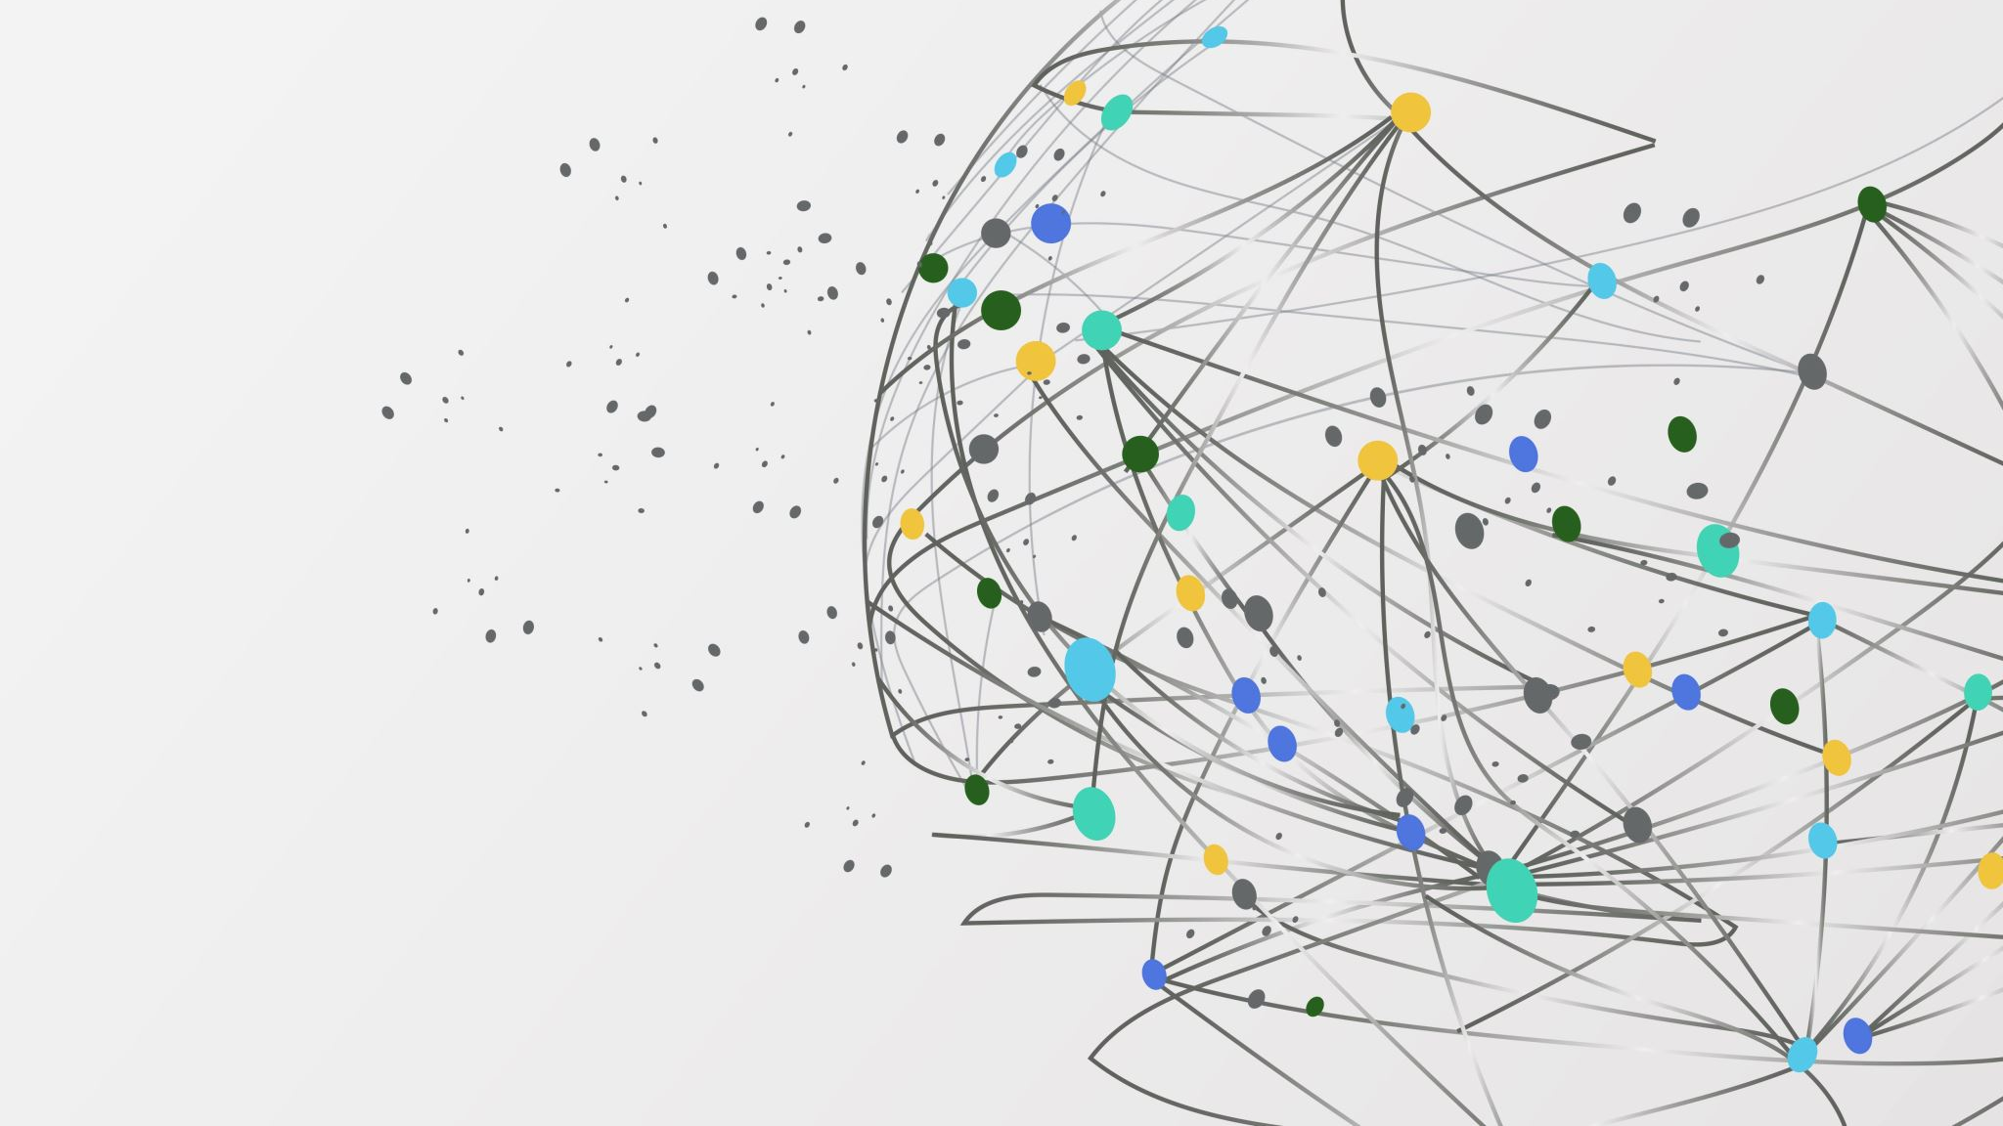

ILLUMINAT3D
NASA’S SPACE APPS CHALLENGE
2021|THESSALONIKI

Slide 2


Our Team
The Challenge
WHEN LIGHT CURVES THROW US CURVE BALLS
Maria Doli|Department of Physics, AUTh
Manolis Eleftheriadis|Department of Informatics, AUTh
Dimitris Komitis|Department of Physics, AUTh
Ioannis Liodis|Department of Physics, AUTh
Konstadina Noula|Department of Physics, AUTh
Eirini Rodiou|Department of Physics, AUTh
“From Earth, the Trojan asteroids appear to be single points of light; their light curves—the way their observed brightness varies with time—are one of the few clues available to scientists working to determine the shapes of these distant bodies. Your challenge is to design a tool that allows users to explore how the shape of an asteroid affects the appearance of its light curve.”

Slide 3

Our Solution
Educative GUI.
Innovative app based on the mathematical analysis of 3D models.
Intuitive approach constructed from scratch.
ILLUMINAT3D
The user can adjust five different parameters.
Producing the light curves of any 3D object inserted (in stl format).
Does not require 3D representation, no need for graphical processing cores.
Notes:
Εδώ θέλω να μπούνε και ένα-δύο ακόμα κυκλάκια. Το ένα θέλω σίγουρα να αφορά την «απόδειξη» της ορθότητας του κώδικά μας.

Slide 4

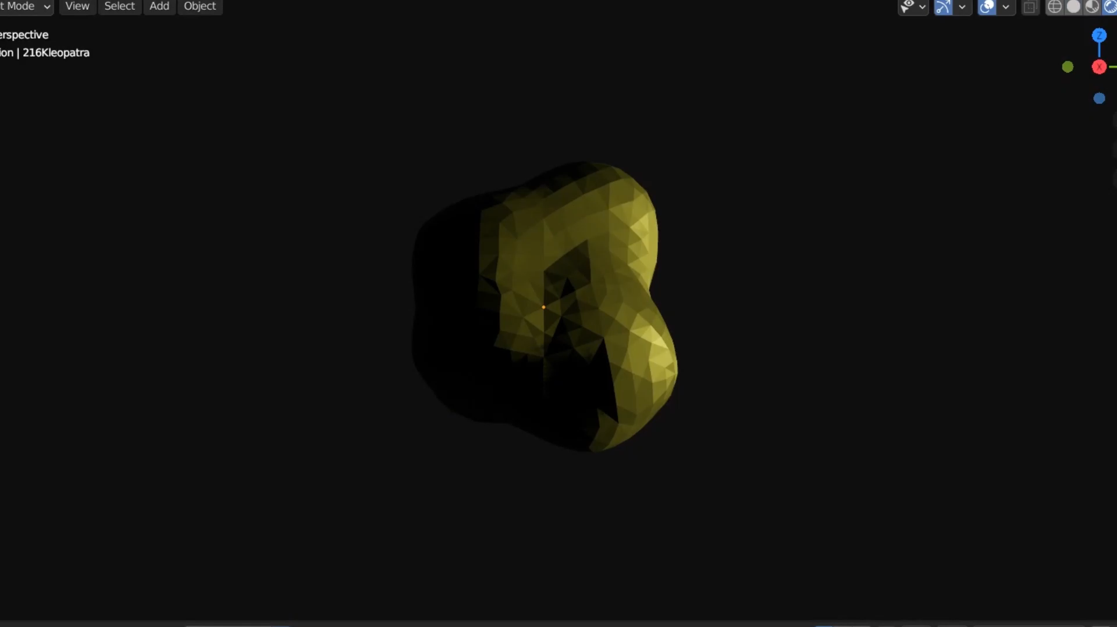
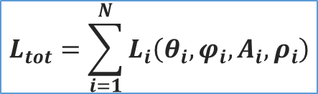
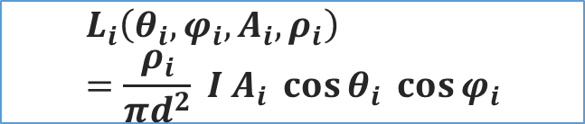
Scientific Background
$$L_{i}\left(θ_{i},φ_{i}, A_{i}, ρ_{i}\right)=\frac{ρ_{i}}{πd^{2}} Ι Α_{i} \cos{θ_{i}} \cos{φ_{i}}$$
$$L_{tot}=\sum_{i=1}^{N}{L_{i}\left(θ_{i},φ_{i},A_{i}, ρ_{i}\right)}$$

Slide 5
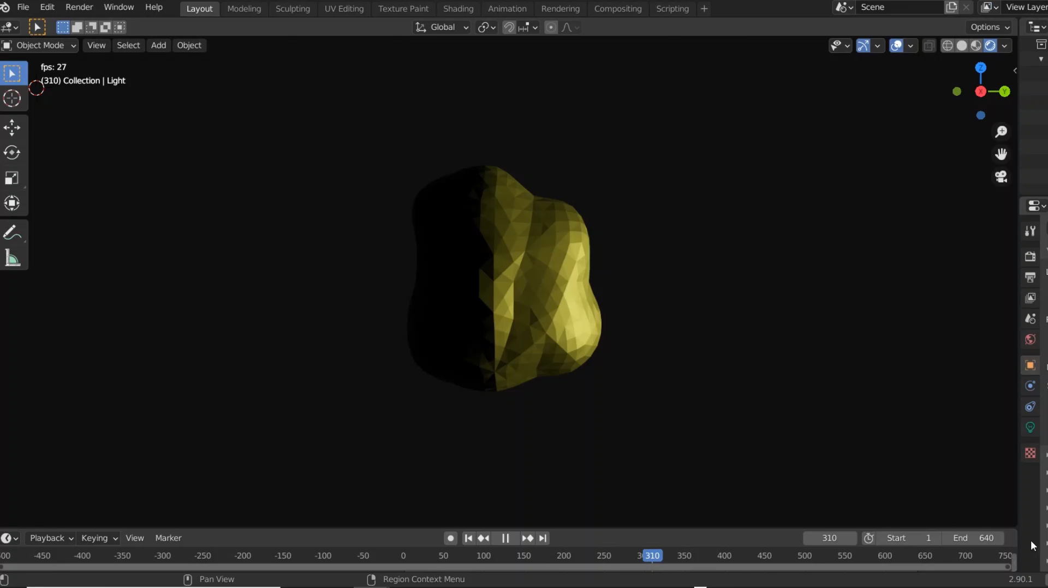
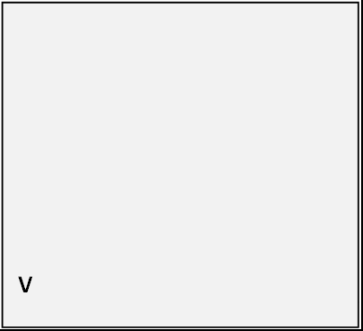
Scientific Background

Slide 6

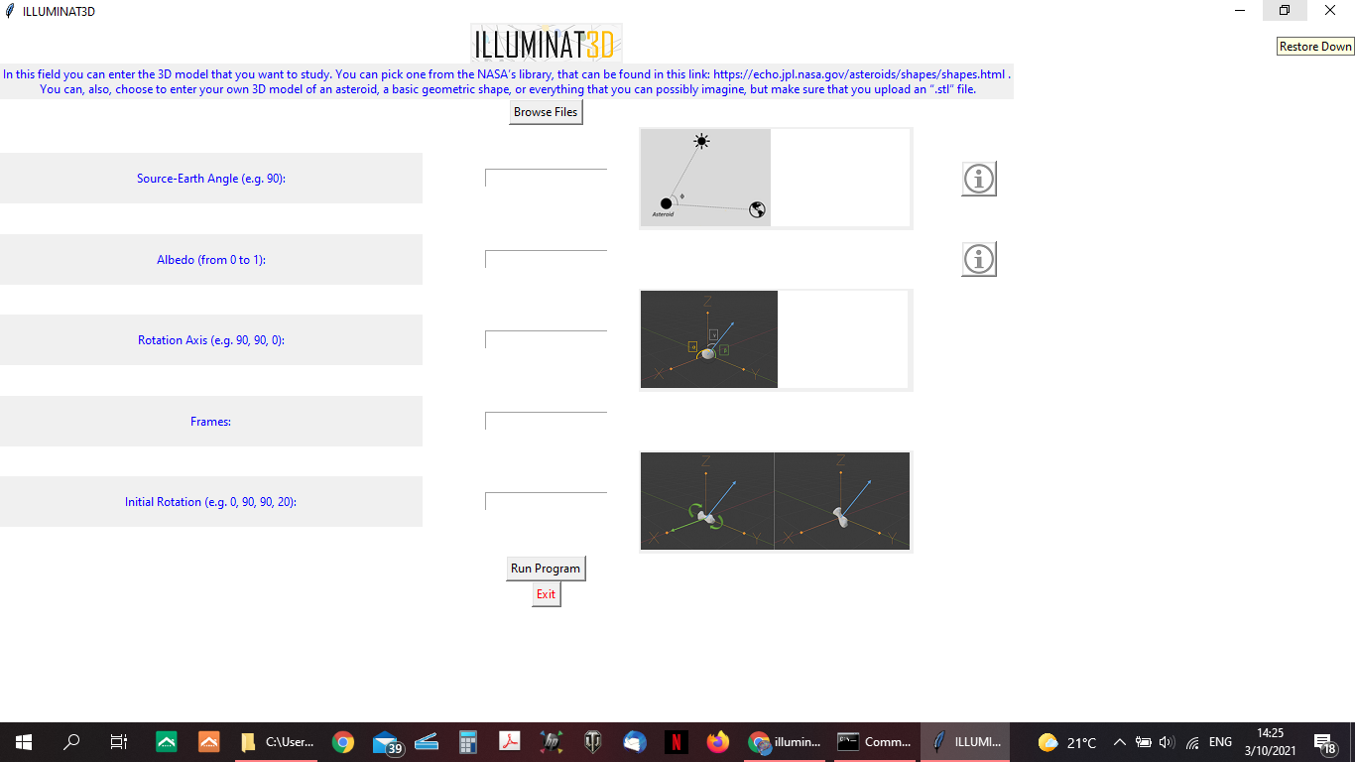
The G.U.I.
Clean,
user-friendly.
Five
parameters.
Explanatory images.
Educative information.

Slide 7
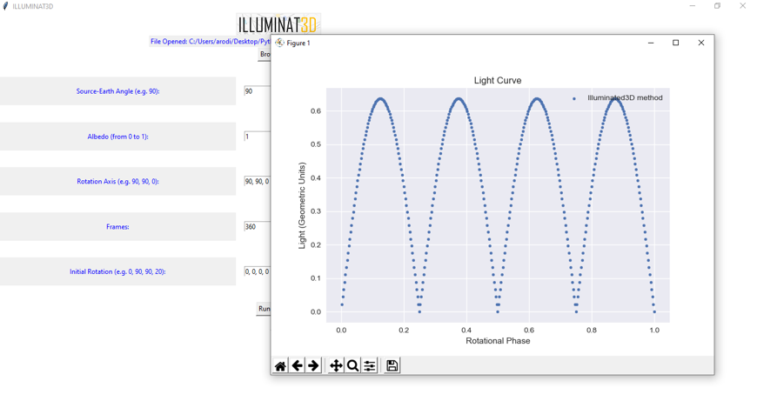
The G.U.I.
Clean,
user-friendly.
Five
parameters.
Explanatory images.
Educative information.
https://github.com/iliodis/Illuminat3D---Nasa-Space-Apps-Challenge

Slide 8

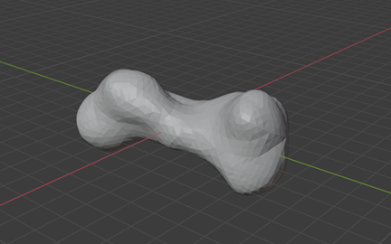
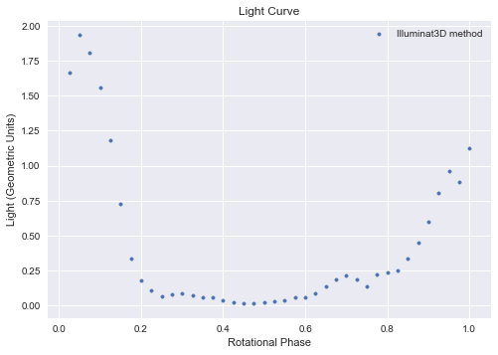
The Plots
Kleopatra
Parameters: No initial rotation, Rotation axis: z, Albedo: 1, Source-Earth angle: 90 deg, Frames: 40.

Slide 9
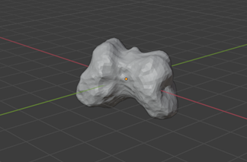
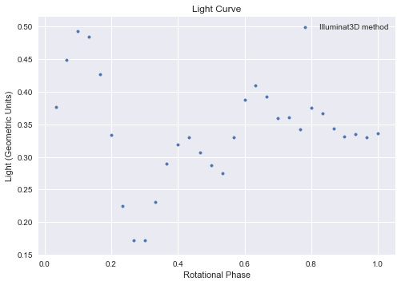
The Plots
Mirtha
Parameters: No initial rotation, Rotation axis: z, Albedo: 1, Source-Earth angle: 90 deg, Frames: 30.

Slide 10
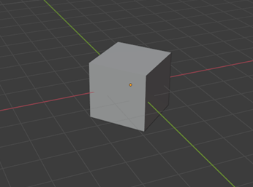
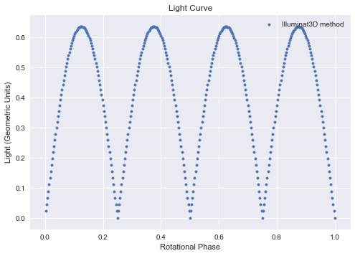
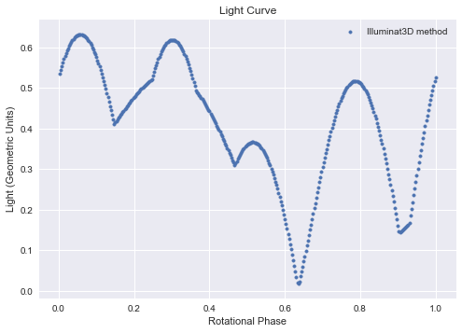
Cube
The Plots
Parameters: No initial rotation, Rotation axis: z, Albedo: 1, Source-Earth angle: 90 deg, Frames: 360.
Parameters: Initial rotation: random, Rotation axis: random, Albedo: 1, Source-Earth angle: 90 deg, Frames: 360.

Slide 11

Thoughts for the Future
Dealing with the reverse problem. We want to develop our app, so we are able to find the shape of an object, by analyzing its light curve.
More parameters will be added, i.e. the ability to analyze a black or grey body, the ability to upload more file types.
Upgrading the GUI, i.e. projection of the estimated time, visualization, design.
Dealing with the errors, that exist due to the use of the shapely library, i.e. contact a specialist, use a different library.

Slide 12
ILLUMINAT3D
THANK YOU, FOR YOUR ATTENTION!
NASA’S SPACE APPS CHALLENGE
2021|THESSALONIKI

